Slide 1

PREDICTION OF RISK OF SEPSIS USING MACHINE LEARNING ON BIG DATA
Mabel Komanduru
Sifat Naseem

Slide 2

INTRODUCTION
Sepsis is a syndromic condition that can lead to delays in treatment.
Delays in antibiotic therapy have been associated with an increase in adjusted mortality of septic patients.
Patients with septic shock are particularly vulnerable to delays in treatment, with mortality increasing by 3.6-9.9% per hour of delay.
Sepsis poses additional financial burdens for developing countries and is associated with a greater risk of negative outcomes.
Overall, sepsis is a significant public health concern resulting in considerable illness, death, and healthcare costs.

Slide 3
AIM
Determine the development of sepsis in hospital-administered patients earlier than the clinical predictions.
DATA: over 1 million ICU patients with up to 40 clinical variables from 3 separate hospitals.
Used Sepsis-3 clinical criteria for sepsis onset. For sepsis patients, sepsis_label is 1 if t > t(sepsis) – 6 and 0 if t < t(sepsis) – 6.
For non-sepsis patients, sepsis_label is 0.

Slide 4
DATA PREPROCESSING
Checking for missing values.
Replacing missing values into ‘0’.
Identifying duplicate values and unique values.
Checking for outliers in ‘heart rate’ and ‘temperature’.
Aggregating the data based on the patient Id to reduce the complexity of the dataset.
Checking for data imbalance and visualizing it for better and easy understanding.

Slide 5
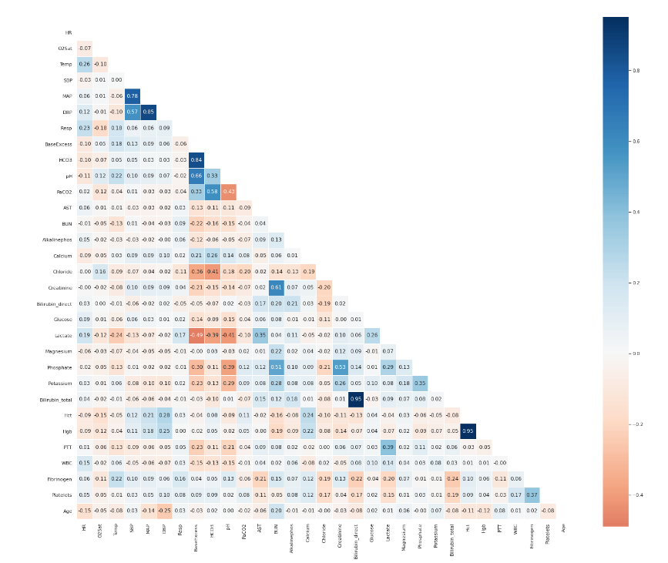
Plotting a correlation matrix:
MAP, diastolic, and systolic blood pressures are highly correlated.
Lactate, PTT, and Phosphate have a high correlation as all are indicators of kidney health.
Fibrinogen and platelets have a high correlation as both define the clotting ability.
Bilirubin_total and Bilirubin_direct have a high correlation.

Slide 6
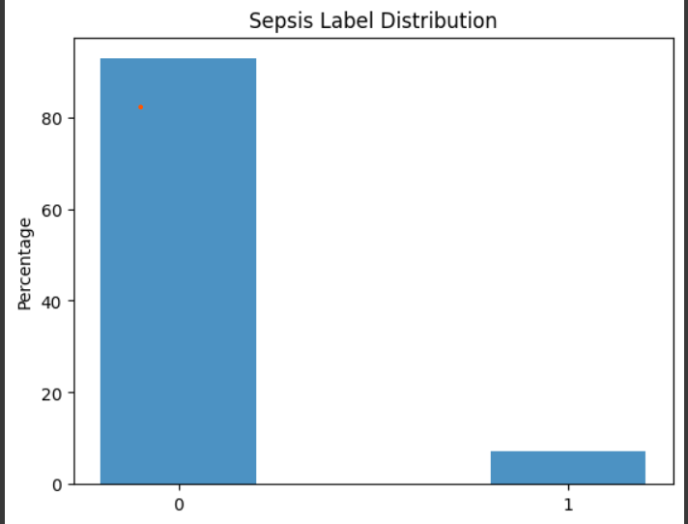
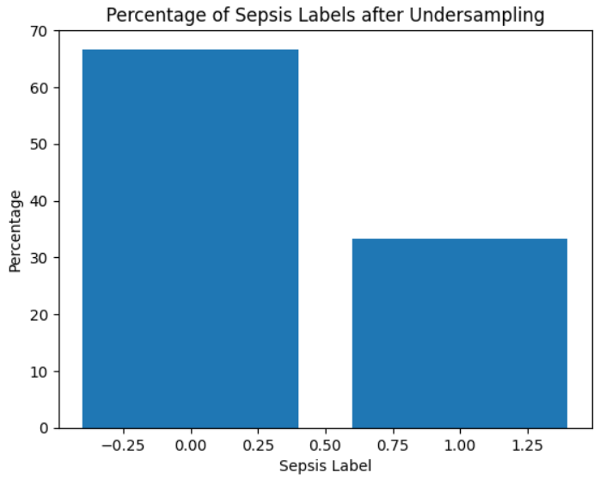
Data imbalance
target value distribution
After under sampling

Slide 7
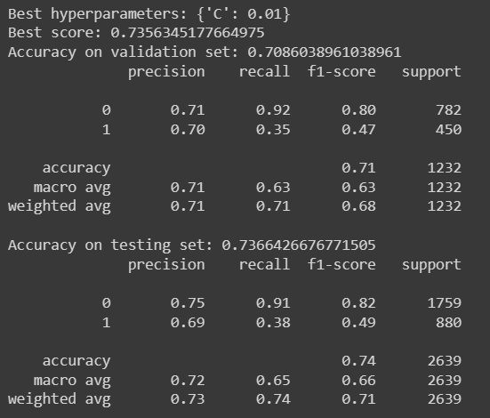
ML CLASSIFIERS
Logistic regression:
Popular choice for binary classification problems; achieves high accuracy
Computationally efficient and works well with large datasets.
Data is split into 60% training, 10% validation, and 30% testing with a random state of 42.
Best hyperparameters: {'C': 100}

Slide 8
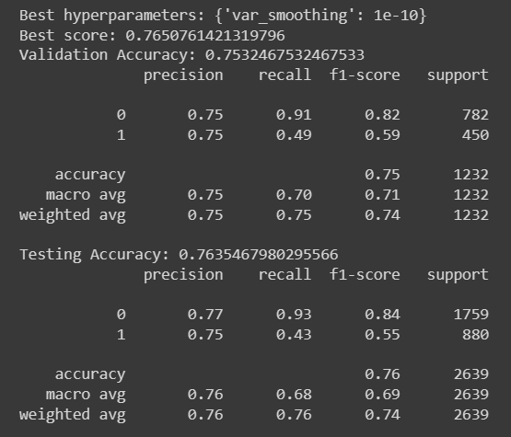
Naïve Bayes:
Fast and easy to predict a class of dataset, good for binary classification
Hyperparameter tuning is done with grid search where 5-fold cross-validation is done.
Best Parameters: {‘var_smoothing’: le-08}

Slide 9
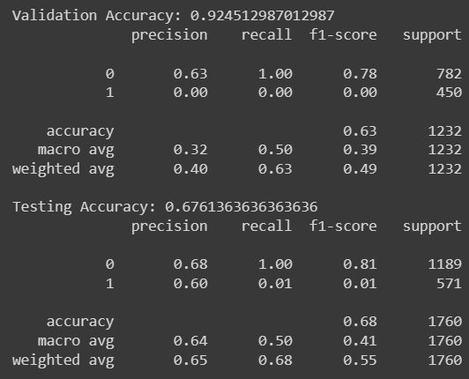
Support Vector Machines:
Memory efficient and works well for classification problems.
Proper separation of decision boundaries.
Hyperparameters used: kernel='rbf’, C=5

Slide 10
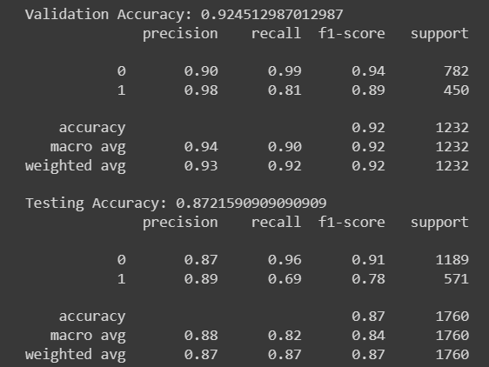
Random Forest:
Most accurate statistical machine learning algorithm and runs accurately and efficiently on large datasets.
Gives an idea about what variables are important for classification.
n_estimators=100, max_depth=10, random_state=42

Slide 11
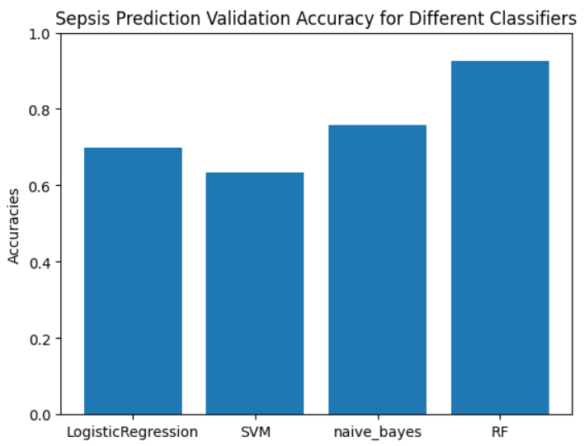
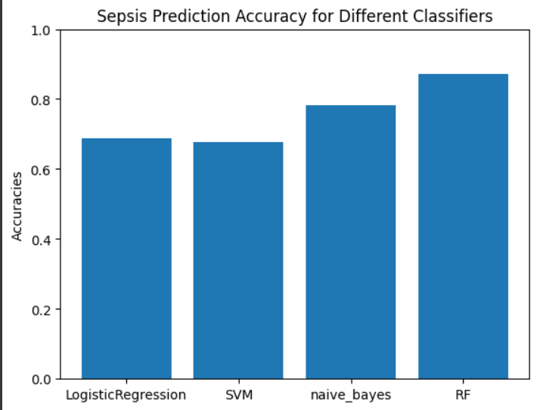
Comparison of accuracies validation set test set

Slide 12
Summary
SVM, LR, and NB may struggle with imbalanced data due to their assumptions about the data distribution or bias towards the majority class.
Overall, RF's ability to handle imbalanced data makes it the best classifier for unequal datasets as it samples a subset of features and data points to build multiple decision trees, making predictions based on the majority vote of all the trees.

